Slide 1
Topic 1: Fundamentals of Logical Algebra
CST205 Digital Logic

Slide 2
Topic Outlines
Number Systems, Binary Code
Axiom of Logical Algebra
Minterm, Maxterm
Simplification of logic functions

Slide 3
Number Systems
Numbering systems are used by digital computers for computation.
Important numbering systems are:
Decimal system (base-10)
Binary system (base-2)
Hexadecimal system (base-16)
Octal system (base-8)

Slide 4

Common Number Systems
System | Base | Symbols | Used by humans? | Used in computers?
Decimal | 10 | 0, 1, … 9 | Yes | No
Binary | 2 | 0, 1 | No | Yes
Octal | 8 | 0, 1, … 7 | No | No
Hexa- decimal | 16 | 0, 1, … 9, A, B, … F | No | No

Slide 5
Decimal Number System
Base (also called radix) = 10
10 digits { 0, 1, 2, 3, 4, 5, 6, 7, 8, 9 }
Digit Position
Integer & fraction
Digit Weight
Weight = (Base) ^{Position}
Magnitude
Sum of “Digit x Weight”
Formal Notation
2
1
0
-1
-2
5
1
2
7
4
100
10
1
0.1
0.01
500
10
2
0.7
0.04
d₂*B²+d₁*B¹+d₀*B⁰+d₋₁*B⁻¹+d₋₂*B⁻²
(512.74)₁₀

Slide 6
Binary Number System
Base = 2
2 digits { 0, 1 }, called binary digits or “bits”
Weights
Weight = (Base) ^{Position}
Magnitude
Sum of “Bit x Weight”
Formal Notation
Groups of bits 4 bits = Nibble
8 bits = Byte
4
2
1
1/2
1/4
1
0
1
0
1
2
1
0
-1
-2
1 *2²+0 *2¹+1 *2⁰+0 *2⁻¹+1 *2⁻²
=(5.25)₁₀
(101.01)₂
1 0 1 1
1 1 0 0 0 1 0 1

Slide 7
Octal Number System
Base = 8
8 digits { 0, 1, 2, 3, 4, 5, 6, 7 }
Weights
Weight = (Base) ^{Position}
Magnitude
Sum of “Digit x Weight”
Formal Notation
64
8
1
1/8
1/64
5
1
2
7
4
2
1
0
-1
-2
5 *8²+1 *8¹+2 *8⁰+7 *8⁻¹+4 *8⁻²
=(330.9375)₁₀
(512.74)₈

Slide 8
Hexadecimal Number System
Base = 16
16 digits { 0, 1, 2, 3, 4, 5, 6, 7, 8, 9, A, B, C, D, E, F }
Weights
Weight = (Base) ^{Position}
Magnitude
Sum of “Digit x Weight”
Formal Notation
256
16
1
1/16
1/256
1
E
5
7
A
2
1
0
-1
-2
1 *16²+14 *16¹+5 *16⁰+7 *16⁻¹+10 *16⁻²
=(485.4765625)₁₀
(1E5.7A)₁₆

Slide 9
Binary System
The binary system represents numbers in only two digit, 0 and 1.
The binary system is a base-2 system.
The position of 0 or 1 in a binary number indicates its weights, or value within the number.
The weights in a binary number are based on the powers of 2.

Slide 10
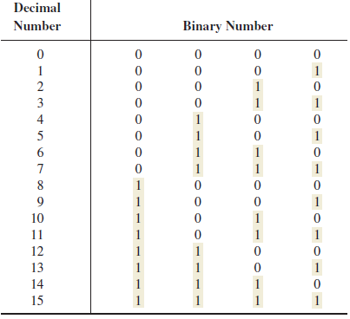

Slide 11

Binary Weights
The weight structure of binary number is
Positive Powers of 2 (Whole numbers) |  |  |  |  |  |  |  |  | Negative Powers of 2 (Fractional Number)
2⁸ | 2⁷ | 2⁶ | 2⁵ | 2⁴ | 2³ | 2² | 2¹ | 2⁰ | 2⁻¹ | 2⁻² | 2⁻³ | 2⁻⁴ | 2⁻⁵ | 2⁻⁶
256 | 128 | 64 | 32 | 16 | 8 | 4 | 2 | 1 | 1 2 | 1 4 | 1 8 | 1 16 | 1 32 | 1 64

Slide 12
Conversion Among Bases
The possibilities:
Decimal
Octal
Binary
Hexadecimal

Slide 13

Conversion of binary number to decimal number
Convert the binary number 1101101 to decimal.
Solution:
Weight:
Binary number:
1101101=(2⁶×1)+(2⁵×1)+(2⁴×0)+(2³×1)+(2²×1)+(2¹×0)+(2⁰×1)
= 64 + 32 + 0 + 8 + 4 + 0 + 1
= 109.

Slide 14
Example
Convert the binary number 10010001 to decimal.
Solution:

Slide 15
Another example with fractional binary number
Convert the fractional binary number 0.1011 to decimal.
Solution:
Weight: 2⁻¹ 2⁻² 2⁻³ 2⁻⁴
Binary number: 0 . 1 0 1 1
0.1011 = (2⁻¹×1) + (2⁻²×0) + (2⁻³×1) + (2⁻⁴×1)
= 0.5 + 0 + 0.125 + 0.0625
= 0.6875

Slide 16
Conversion of decimal number to binary number
Convert the following decimal numbers to binary:
(a) 19 (b) 45

Slide 17
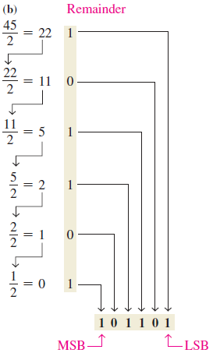
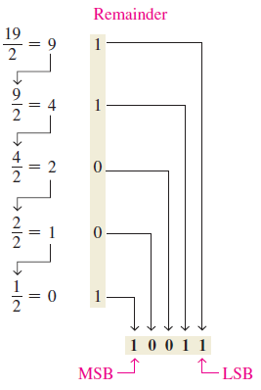
Solutions
(a) 19 = 10011₂
(b) 45 = 101101₂

Slide 18
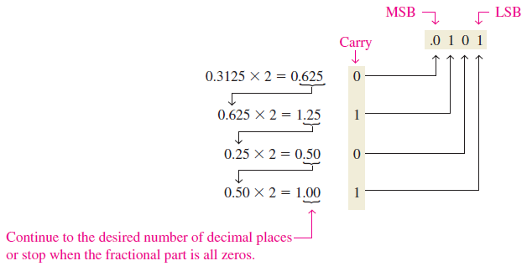
Convert decimal to fractional binary number
Convert decimal 0.3125 to binary.
Answer: 0.3125 = 0.0101₂.
Method: Repeated multiplication by 2 as follows:

Slide 19

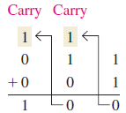
Addition in binary system
The 4 basic rules of adding binary digits (or bits) are:
For example, add binary 11 to binary 1:

Slide 20
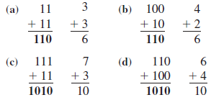
More addition examples
Add the following binary numbers:
(a) 11+11 (b) 100+10 (c) 111+11 (d) 110+100
Solutions:

Slide 21
Binary subtraction
The 4 basic rules for subtracting bits are:
0 − 0 = 0
1 − 1 = 0
1 − 0 = 1
10 − 1 = 1

Slide 22

Example of binary subtraction
Perform the following binary subtraction:
(a) 11 − 01 (b) 11 − 10
Solution:

Slide 23
Binary multiplication
The 4 basic rules for multiplying bits are:
0 × 0 = 0
0 × 1 = 0
1 × 0 = 0
1 × 1 = 1

Slide 24
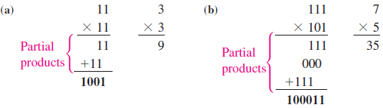
Example of binary multiplication
Perform the following binary multiplications:
(a) 11 × 11 (b) 101 × 111
Solution:

Slide 25
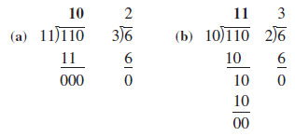
Binary division
Perform the following binary division:
(a) 110 ÷ 11 (b) 110 ÷ 10
Solution:

Slide 26
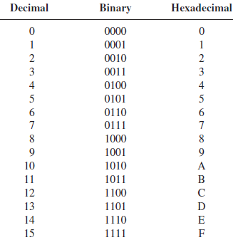
Hexadecimal system
The hexadecimal number system has a base 16. It is composed of 16 numeric (0-9) and alphabetic characters (A-F).

Slide 27

Binary to Hex Conversion
Convert the following binary numbers to hexadecimal:
(a) 1100101001010111 (b) 111111000101101001
Solution:

Slide 28
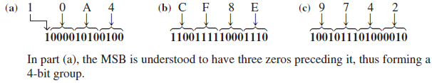
Hex to Binary Conversion
Determine the binary numbers for the following hexadecimal numbers:
(a) 10A4₁₆ (b) CF8E₁₆ (c) 9742₁₆
Solution:

Slide 29
Octal System
The octal system is base-8. It is composed of 8 digits, which are:
0, 1, 2, 3, 4, 5, 6, 7
To count above 7, begin another column and start over:
10, 11, 12, 13, 14, 15, 16, 17, 20, 21, ...

Slide 30
Octal to Binary Conversion
Because each octal digit can be represented by a 3-bit binary number, it is very easy to convert from octal to binary.
Each octal digit is represented by 3 bits as shown in table below.
Octal Digit | 0 | 1 | 2 | 3 | 4 | 5 | 6 | 7
Binary | 000 | 001 | 010 | 011 | 100 | 101 | 110 | 111

Slide 31

Example of octal to binary conversion
Convert each of the following octal number to binary:
(a) 13₈ (b) 25₈ (c) 140₈ (d) 7526₈
Solutions:

Slide 32
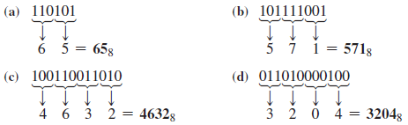
Binary to Octal Conversion
Convert each of the following binary numbers to octal:
(a) 110101 (b) 101111001 (c) 100110011010
(d) 11010000100
Solutions:

Slide 33
Octal − Hexadecimal Conversion
Convert to Binary/Decimal as an intermediate step
Example:
( 2 6 . 2 )₈
Assume Zeros
Assume Zeros
( 0 1 0 1 1 0 . 0 1 0 )₂
( 1 6 . 4 )₁₆
Works both ways (Octal to Hex & Hex to Octal)

Slide 34
Signed Numbers
A signed binary number consists of both sign and magnitude information.
The sign indicates whether a number is positive or negative, and the magnitude is the value of the number.
There are 3 forms in which signed integer numbers can be represented in binary:
Sign-magnitude
1’s complement (the first complement)
2’s complement (the second complement)

Slide 35

Sign-Magnitude Form
The left most bit is the sign bit and the remaining bits are the magnitude bit.
A negative number has the same magnitude bits as the corresponding postive number but the sign bit is a 1 rather than a 0.
For example, +25 in sign-magnitude form is:
While −25 in sign magnitude form is:
10011001

Slide 36
1s Complement
Positive numbers in 1’s complement form are represented the same way as the positive sign-magnitude form.
Negative numbers are the complements of the corresponding bits of the positive numbers.
For example, using 8-bits, the decimal number −25 is expressed as complement of all bits in +25 = 00011001 as
11100110

Slide 37
2s Complement
Positive numbers in 2’s complement form are represented the same way as in the sign-magnitude and 1’s complement forms.
Negative numbers are the converted by first inverting the bits in the corresponding positive numbers, then add 1 to the inverted bits.
For example, −25 is converted to 2’s complement is:
+25 = 00011001 inverted to 11100110, then add 1 to become 11100111

Slide 38

Example of signed number representations
Express the decimal number −39 as an 8-bit sign magnitude, 1’s complement and 2’s complement forms.
Solution:
+39 = 00100111
Sign-magnitude: 10100111
1’s complement: 11011000
2’s complement: 11011001

Slide 39
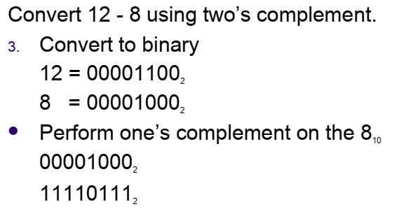
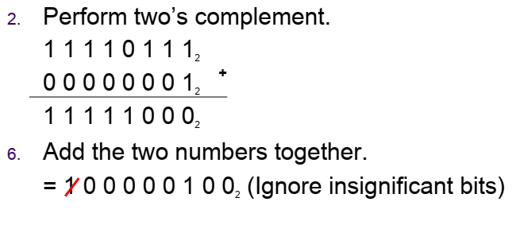
2s Complement

Slide 40

Any Questions

